Slide 1
RAINFALL PREDICTION USING ARIMA AND LINEAR REGRESSION MODEL
BATCH:- A12
DOMAIN:- Machine Learning
NAME:- Supriya.S (211418104275)
Surya.P (211418104278)
Swetha. N (211418104284)
GUIDE NAME:- Dr.K.Sangeetha

Slide 2
ABSTRACT
Rainfall forecasting is very important because heavy and irregular rainfall can have many impacts like destruction of crops and farms, damage of property so a better forecasting model is essential for an early warning that can minimize risks to life and property and also managing the agricultural farms in better way.
The proposed scheme provides annual rainfall prediction and four seasonal rainfall predictions such as summer, autumn, rainy, and winter.
The ARIMA trained on 1400 epoch for revealing very good results. Linear regression is acted as the best optimizer.
The ARIMA model revealed better accuracy in all of the seasonal and annual rainfall.
We use the real data from Indian government website www.data.gov.in and compare the model quality based on several criteria in ARIMA.

Slide 3
EXISTING SYSTEM
The time series analysis is recorded to solve problems such as drought, flood and other agricultural problems and used a machine learning model to forecast the future values of Tamilnadu Monsoon rainfall.
The time-series forecasting of rainfall in Tamilnadu is carried out by statistical methods such as the Seasonal Arima model.
The performance of this model is evaluated based on the metrics such as Mean Squared Error (MSE) and Root Mean Squared Error (RMSE).
The derived model could be used to forecast Monsoon rainfall.

Slide 4
PROPOSED SYSTEM
The proposed system developed a rainfall prediction system using Linear regression and ARIMA algorithm to analyze rainfall data of India and predict the future rainfall.
We used the rainfall data collected from the official website of the Indian government.The data comprises over a decade of measurement of rainfall in India.
The proposed system used various feature selection mechanisms such as technical indicator, fundamental analysis, Fourier transforms Linear regression and ARIMA model.
Also, it used variable auto-encoder (VAE) for high-level feature pattern and PCA and XGB for dimensionality reduction. Bayesian optimization is applied to direct the search path to determine the objective function based on the conditional probability.

Slide 5
HARDWARE REQUIREMENT
Ram - 4 GB and above
Software ID - Python IDLE
Hard Disk - 1 tb
Processor - I5 and above

Slide 6
SOFTWARE REQUIREMENT
Operating System - Windows 8/10
Front End - CSS
Language - Python(3.10) Version.
Server - Flask.

Slide 7
MODULES
Data Exploration and Analysis.
Data Preprocessing.
Linear Regression.
ARIMA (Auto Regressive Integrated Moving Average).
Ensemble Methods and Bagging.

Slide 8
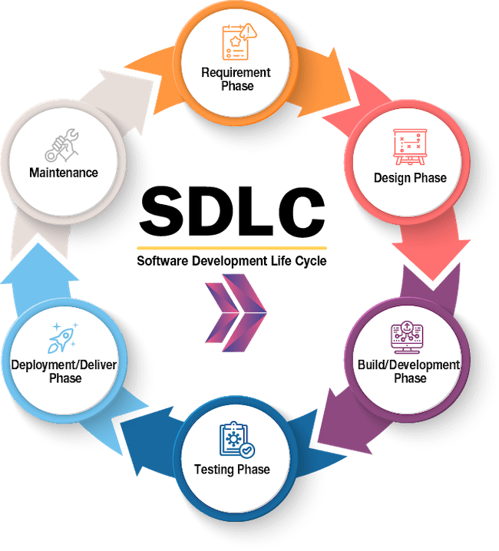
SDLC

Slide 9
TIMELINE CHART

Slide 10
REFERENCES
Cmak Zeelan Basha, Nagulla Bhavana, Ponduru Bhavya, Sowmya V, (Year 2020), “Rainfall Prediction using Machine Learning & Deep Learning Techniques”, IEEE, Coimbatore, 10.1109/ICESC48915.2020.9155896
Arnav Garg, Himanshu Pandey, (Year 2019), “Rainfall Prediction using Machine Learning”, International Journal of Innovative Science and Research Technology, Kanchipuram, Volume 4
Refonaa.J,Lakshmi.M,Dhamodaran.S,Teja Surya, Pradeep.T.N.M, (year 2019), “Machine Learning Techniques for Rainfall Prediction Using Neural Network”, Journal of Computational and Theoretical Nanoscience, American Scientific Publishers, Chennai , Volume 16, https://doi.org/10.1166/jctn.2019.8185

Slide 11
REFERENCES
Muchamad Taufiq Anwar, Saptono Nugrohadi, Vita Tantriyati, Vikky Aprelia Windarni,(Year2020), “Rain Prediction Using Rule-Based Machine Learning Approach”, Advance Sustainable Science Engineering and Technology, Universitas PGRI Semarang, 0.26877/asset.v2i1.6019
Shilpa Manandhar; Soumyabrata Dev; Yee Hui Lee; Yu Song Meng, (Year 2019), “A Data-Driven Approach for Accurate Rainfall Prediction”, IEEE
"Rainfall Prediction using Machine Learning Approach: A Case Study for the State of Odisha", (Year 2020), "Rainfall Prediction using Machine Learning Approach: A Case Study for the State of Odisha", Indian Journal of Natural Sciences, Odisha, Vol.10
Wanie M.Ridwan,Michelle Sapitang,Awatif Aziz, (Year 2021), “Rainfall forecasting model using machine learning methods: Case study Terengganu, Malaysia”, Ain Shams Engineering Journal, Malaysia, Volume 12, Pages 1651-1663.

Slide 12
REFERENCES
B. Suganya, R. Kingsy Grace, (Year 2020), “Machine Learning based Rainfall Prediction”, 6th International Conference on Advanced Computing and Communication Systems, Coimbatore, IEEE, 10.1109/ICACCS48705.2020.9074233
Y Zhao, X Meng, T Qi, Y Li, G Chen, D Yue, F Qing, (Year 2022), “AI-based rainfall prediction model for debris flows”, Gansu Tech Innovation Centre for Environmental Geology and Geohazard Prevention, China, 0.1016/j.enggeo.2021.106456
Emilcy Hernández,Victor SanchezAnguix,Vicente Julian,Javier Palanca,Nestor Duque, (Year 2016), "Rainfall Prediction: A Deep Learning Approach", International Conference on Hybrid Artificial Intelligence Systems, United Kingdom, 10.1007/978-3-319-32034-2_13

